Slide 1
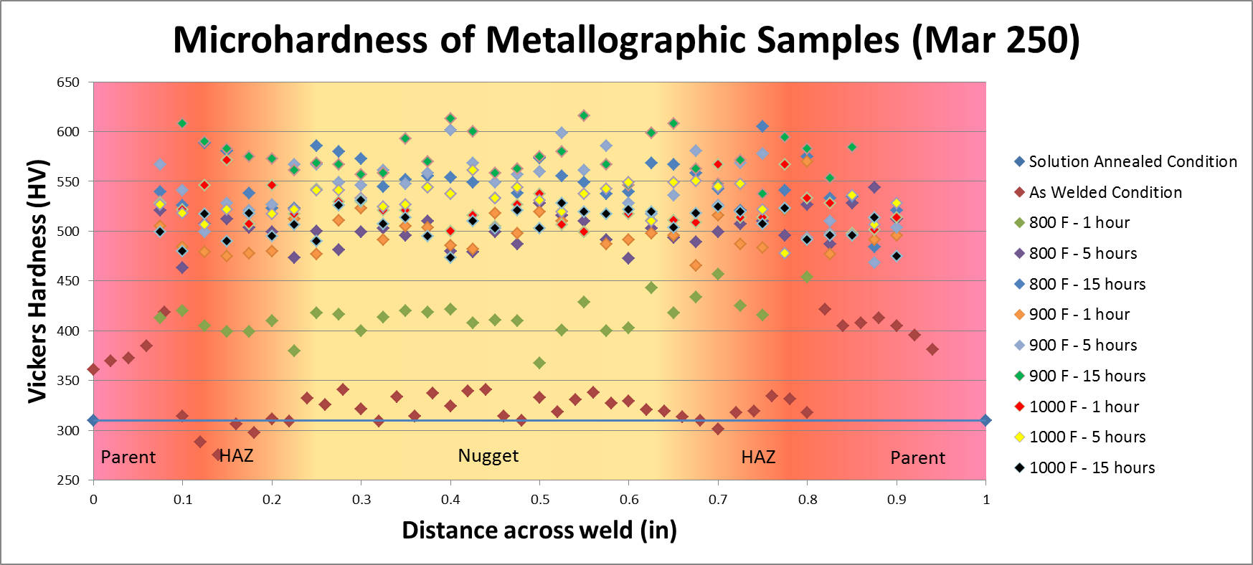
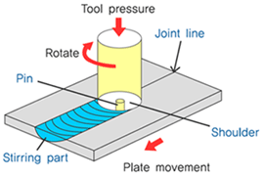
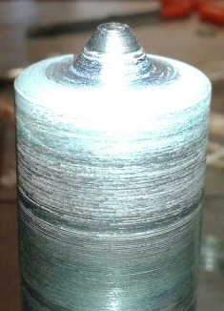
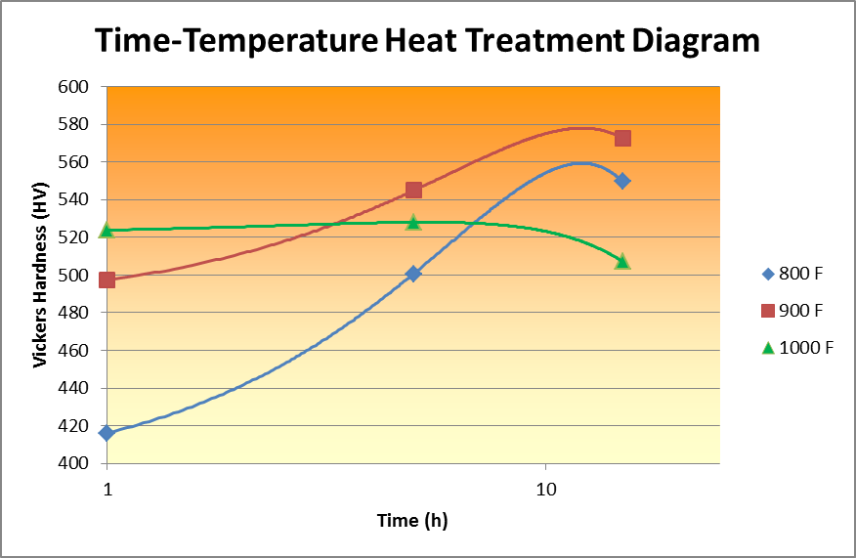
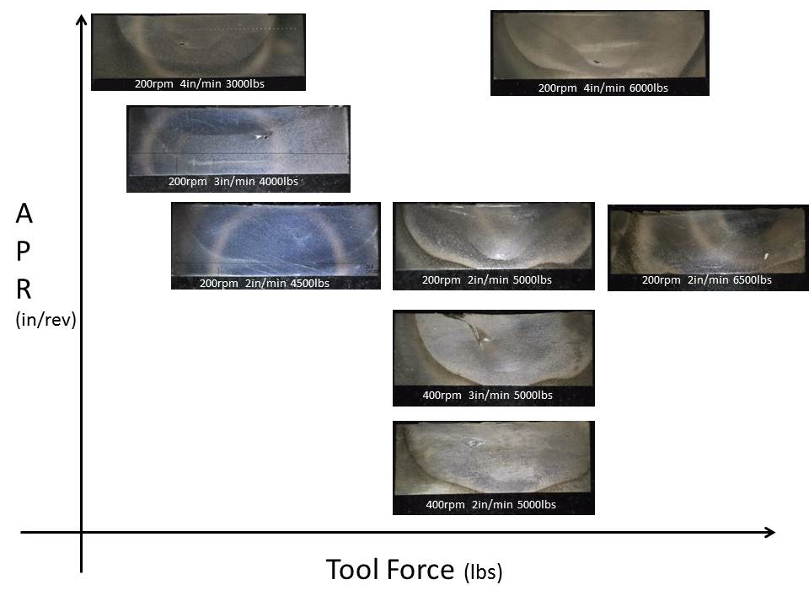
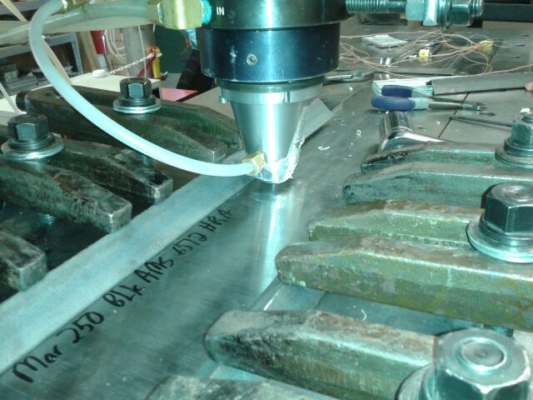
Friction Stir Welding Techniques Applied to Maraging Steel Research Undergraduate: Brendan Kellogg Faculty Advisors: Drs. Bharat Jasthi and Michael West
Introduction
Friction stir welding is a materials joining process in which melting of the parent material is not necessary. Instead, a tool exerts enough downward force and rotates quickly enough that it is able to “stir” the solid material together with friction.
Procedure
Parent Material
Mechanical Testing
Parameter Optimization
Post Weld Heat Treatment
Metallography
Metallography
Mechanical Testing
Fig. 1 – FSW Process
Fig. 2 – FSW Tool
Conclusions
Maraging Steel
Specialized aerospace material
High strength to weight ratio
Maintains properties at elevated temperatures
Little to no carbon content
Majority of strength obtained in a post-machining heat treatment known as “precipitation hardening” or “aging”
Composition
Lath martensitic ferrous matrix solution
18% Ni, 8% Co, 5% Mo
“Maraging” – portmanteau: “martensite” and “aging”
Results
Parameter Mapping
Conclusions
Optimal welding parameters involve high levels of heat. The best welds were specifically conducted at 6500 lbs. force rotating at 200 rpm and traveling at 2 in/min.
Lower, slower heat treatments yield the best mechanical properties. The best results in this case were achieved by heat treating at 900 Fahrenheit for 15 hours.
Hardness properties tend to even out across the weld nugget and HAZ with the correct heat treatment.
Future Work
Furthering this research would involve a full mechanical property (tensile, fracture toughness, impact, etc.) and metallography (microstructure, grain size, etc.) analysis of the optimal welding parameters. Further data could be gathered on parameter refinement and longer heat treating times. Research could also be conducted on tool wear during this process.
Fig. 3 – Parent Material Microstructure
Fig. 4 – FSW Machine
Objectives
1. Develop a parameter optimization map for future
use in friction stir welding maraging steel.
2. Develop a Time-Temperature diagram describing
post-weld heat treatments and their effect on
mechanical properties.
Fig. 5 – Wormhole Welding Defect
Fig. 6 – Weld Nugget Microstructure
Acknowledgments: Funding for this research was provided by the National Science Foundation, Grant #1157074. A special thanks is extended to Drs. Bharat Jasthi and Michael West, to the AMP Center especially Todd, Tim, Matt, and Chris, and to Julia Funke. Without their help this project would not have been possible.

